Slide 1
Digital Portfolio
STUDENT NAME: Keerthana Y
REGISTER NO AND NMID: 31224u09047
DEPARTMENT: BCA
COLLEGE: COLLEGE/ UNIVERSITY
Islamiah womens arts and science college

Slide 2
PROJECT TITLE
Update portfolio

Slide 3


AGENDA
Problem Statement
Project Overview
End Users
Tools and Technologies
Portfolio design and Layout
Features and Functionality
Results and Screenshots
Conclusion
Github Link
3/21/2024 Annual Review

Slide 4

PROBLEM STATEMENT
In today's digital era, having a personal portfolios essential for showcasing skills, projects, and achievements. However, many existing portfolios are either outdated, lack responsive design, or fail to highlight the individual's capabilities effectively. An outdated portfolio reduces opportunities for visibility, professional networking, and career growth. The problem lies in creating or updating a portfolio that is modern. interactive, responsive, and user-friendly. The updated portfolio should allow seamless navigation, properly display skills and projects, integrate multimedia elements, and be accessible across devices. Therefore, the objective is to update the existing portfolio with improved design. functionality, and content presentation so that it serves as a professional digital identity and effectively communicates the individual's strengths potential recruiters, collaborators, or Clients.

Slide 5

PROJECT OVERVIEW
To provide a comprehensive project overview, I'll need more information about the project. Could you please provide details such as: 1. *Project Name*: What is the name of your project? 2. *Objective*: What is the main objective or goal of your project? 3. *Scope*: What features or functionalities will your project include? 4. *Target Audience*: Who is your target audience or user base? 5. *Technical Requirements*: Are there any specific technologies, tools, or programming languages you need to use? Once I have this information, I can help you create a more detailed project overview. If you don't have all the details, that's okay! We can work together to flesh out the project scope and objectives. Let's get started!

Slide 6

WHO ARE THE END USERS?
1. Recruiters / Hiring Managers They check the portfolio to assess your skills, projects, and achievements before offering internships or jobs.2. Potential Clients For freelancers or service providers, clients use the portfolio to evaluate past work and decide whether to hire for projects.3. Academic Institutions/Faculty Teachers, mentors, or evaluators may use the portfolio to verify project submissions, certifications, and learning outcomes. 4. Peers & Collaborators Fellow students, colleagues, or professionals may explore the portfolio to collaborate on projects. startups, or research. 5. Networking Communities Professionals on platforms like Linkedin or GitHub might view the portfolio to understand your expertise and connect.6. Self (The Portfolio Owner) The portfolio also serves as a personal progress tracker, helping the individual organize their skills, showcase growth, and stay updated with trends

Slide 7

TOOLS AND TECHNIQUES
Tools: HTML5 & CSS3-Structure and styling of the portfolio. Java Script-Adding interactivity and dynamic features. Bootstrap/Tailwind CSS-For responsive and modern design.VS Code/Sublime Text-Code editor for development.Git & GitHub-Version control and hosting the portfolio. Canva/Figma-Designing layouts, icons, and graphics Techniques: Responsive Design-Ensuring compatibility across devices. UI/UX Principles-For better navigation and user experience. SEO Basics-Optimizing portfolio visibility in search engines. Content Organization-Clear sections for skills, projects. and contact.Testing & Debugging-Checking functionality and fixing errors.

Slide 8
POTFOLIO DESIGN AND LAYOUT
Header Section Name, logo, and navigation menu. Home/Introduction-Brief intro with a professional photo or tagline About Me Personal background, education, and interests Skills-Technical and soft skills displayed with icons or progress bars. Projects-Showcase of completed projects with descriptions and links. Certifications/Achievements-Display of badges, awards. or credentials. Contact Section Email, phone, social media links, and contact form. Footer-Copyright, quick links, and acknowledgments. Design Approach:Clean and minimal layout Responsive grid system Consistent color scheme and typography Use of icons, cards, and hover effects for interactivity
8

Slide 9
FEATURES AND FUNCTIONALITY
Features: Modern and responsive design (works on desktop. tablet, mobile). Clear navigation menu for easy access to sections.Well-structured sections (About. Skills. Projects. Certifications. Contact) Interactive elements (hover effects, animations, transitions). Integrated links (GitHub, Linkedin. Resume. Email). Professional color scheme and typography. Functionality: Smooth scrolling and user-friendly navigation. Contact form with email functionality. Preject showcase with live demo and source code links. Search. engine friendly (basic SEO). Fast loading and optimized performance

Slide 10
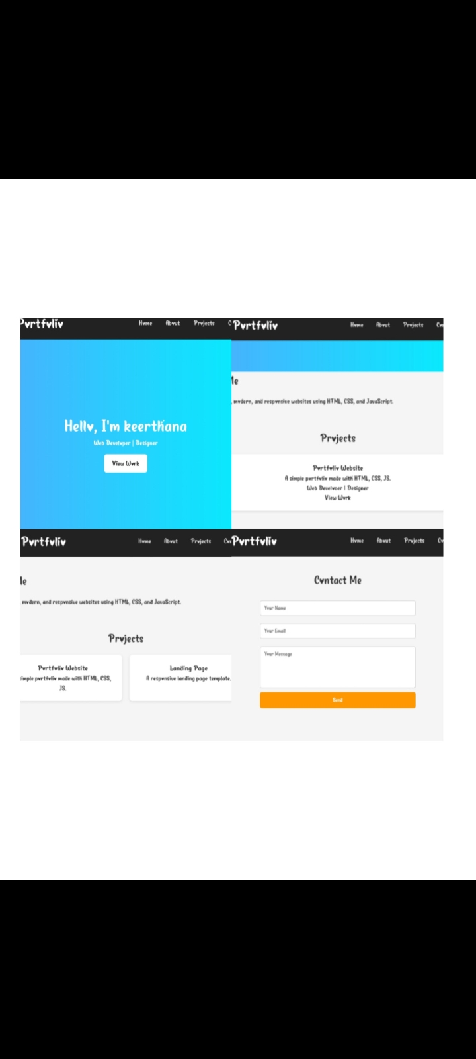

RESULTS AND SCREENSHOTS
3/21/2024 Annual Review
10

Slide 11
CONCLUSION
Updating a portfolio is an essential stepin building a strong digital identity. The redesigned portfolio provides a modern, responsive, and user-friendly platform to showcase skills, projects, and achievements effectively. By integrating updated. design principles, interactive features, and organized content, the portfolio now serves as a professional tool for career growth, academic recognition, and networking, opportunities. Overall, this project ensures that the portfolio is not only visually appealing but also functional and relevant to current industry standards.
11

